Slide 1
ASR Training: Regional Weekend Hosted by North Area
July 17, 2021 North East Zonal Forum Fellowship Development
Craig R

Slide 2
All the material contained in this workshop was obtained through two experience gathering workshops hosted by the North East Zonal Forum on Regional Committee Member (RCM) best practices. The information being shared today came from RCM experiences from across the Fellowship. Everything in this workshop is merely a suggestion and we hope that this information is useful to you in your service efforts.

Slide 3
North East Zone (NEZF) Fellowship Development Purpose
The Northeast Zonal Forum (NEZF) Fellowship Development subcommittee's purpose is to effectively increase the awareness and recognition of NA as a viable program of recovery through collaborating with the groups and service bodies. Through this collaboration, we hope to improve our service delivery's effectiveness and efficiency throughout the Zone. We will actively work to search and build effective relationships within the NEZF and seek opportunities to provide fellowship development services to our membership as needed. We will help our members and groups become more aware of how FD can better carry our message.

Slide 4
Agenda
Know Your Area
The Basics: Your Role
This workshop is divided into 4 sections:
Know the NA Service Structure
Know Your Region

Slide 5
The Basics

Slide 6
Regional Committee Member: The Basics
The Regional Committee Member - more commonly referred to as the RCM - is a service position elected by an Area service committee
The RCM is the direct link between the Area and Regional service bodies
The RCM carries the conscience of the local Area to Region and Regional information back to the Area. The primary means of doing this is through reporting (Concept 3)
The regional committee also serves year around as a contact point between NA world and local services

Slide 7
The Guide to Local Service (GTLS) Says…
Keep your Area in touch with the larger world of NA by providing information on:
Activities in neighboring areas
Functions being sponsored by the regional committee
Reports relevant to the Area’s subcommittee affairs
Important issues being discussed at various levels of service

Slide 8
The GTLS Says …
RCMs need to be well-versed in practices and principles (Concept 4)
Twelve Traditions
Twelve Concepts
Fundamentals of service in our fellowship
All published service manuals and bulletins
The resources of the whole fellowship
can be at the RCM’s fingertips!

Slide 9
Know Your Area

Slide 10
Know Your Area: Groups
How many Groups/meetings are in your Area?
Attend Group Business meetings to listen for Group Conscience.
Get a list of the GSRs for the Area and reach out and introduce yourself.

Slide 11
Know Your ASC
Does your area meet in person, virtually, or hybrid?
When and where does the ASC meet?
When and where do the Area subcommittees meet?
How does your Area communicate between ASC meetings?

Slide 12
Know Your ASC
How do you get in touch with someone if you have a question? Is there an area Contact list?
Website/Facebook page?
Literature distribution method?
Area convention?
Area events?

Slide 13
Know Your Area Subcommittees
What subcommittees are currently active?
How many H&I meetings are there?
Are there positions that need to be filled?
What services are offered at the Area?
What services would the Area like to have?

Slide 14
Know Your Area Policy: They Differ
Responsibilities of RCM/RCMA
Decision making procedures
Budgeting
Information dissemination practices
PR, H&I and Event policies

Slide 15
Area Reporting 101
The RCM is the link between the Area and Region
Reporting can be attractive and effective reporting can invite new members into service
There are many challenges to reporting...

Slide 16
Challenges of Area Reporting
Area and Regional service committee meetings often meet for several hours and it difficult to condense into a 2-3 minute report
Limited experience writing reports
Lack of guidance or feedback on reports
Large pile of reports, announcements, events, action items for area input, NAWS info, etc, etc, etc, to distill for your report to the area

Slide 17
Area Report: What to Include
When and where the next RSC is meeting
Open positions
Upcoming activities, workshops, or learning days
Topics in need of Area/Group input
Topics/proposals that were discussed at Region
Overview of Finances including RSC contribution to WSC
Subcommittee updates
Highlights from Delegate Team Report

Slide 18
Reporting – Suggestions I
Create 2 reports: Summarized & Detailed Version
Give summarized version at Area
Attached detailed version to the RCM report being sent out with the minutes and inform members of where they will be
Avoid information overload in the summarized report

Slide 19
Reporting – Suggestions II
Utilize bullet points and color to help the information be accessible and attractive
Keep information objective vs. subjective
Make sure reported information is consistent
If including Anniversaries, include ALL anniversaries

Slide 20
Reporting - Limitations
Members vary in experience level - beware of use of Abbreviations and Acronyms.
There are a lot of people living without high-speed internet and a lack of access to technology.
If possible, bring hard copies of flyers to the ASC and/or RSC.

Slide 21
Lessons Learned: Listen
Listen to the voice of the groups, not just the outcome of a particular topic or motion during the ASC (Concept 8)
Listen and identify what is important to the Groups to better understand what they would like the RCM to report (issues, successes) `
Listen to the unspoken words of the Area to better hear the conscience (Concept 6)
An RCM can learn a lot about an Area based on what kinds of questions are being asked, what concerns are raised and what topics are celebrated and cheered.

Slide 22
Lessons Learned: Bring Enthusiasm!
The RCMs are in part responsible to make the connection between members and what service means in carrying the message.
RCMs can make or break the perception of Regional Service and beyond.
Bring passion and enthusiasm to workshops which is attractive and encourages group/member participation.

Slide 23
Know Your Region and Your Role Louisiana Region of Narcotics Anonymous – Serving the State of Louisiana (larna.org)

Slide 24
Effective Communication and Collaboration
Regional committee members (RCMs) form the core of the RSC, complemented by the regional delegate and alternate delegate
The ASC communicates directly with its regional service committee through its RCMs, helping to provide guidance to the RSC from the area’s groups
At RSC meetings, RCMs share with one another the information and experience of their respective areas
Some regions also choose additional long- and short-term committee members for their special expertise to perform specific tasks

Slide 25
What Other RCMs advise
Sit next to a more experience member.
Gather phone numbers/emails and reach out.
Obtain and familiarize yourself with the RSC Policy.
Remember: Region is answerable to Areas, not the other way around.

Slide 26
Be Familiar with the NA Service Structure

Slide 27
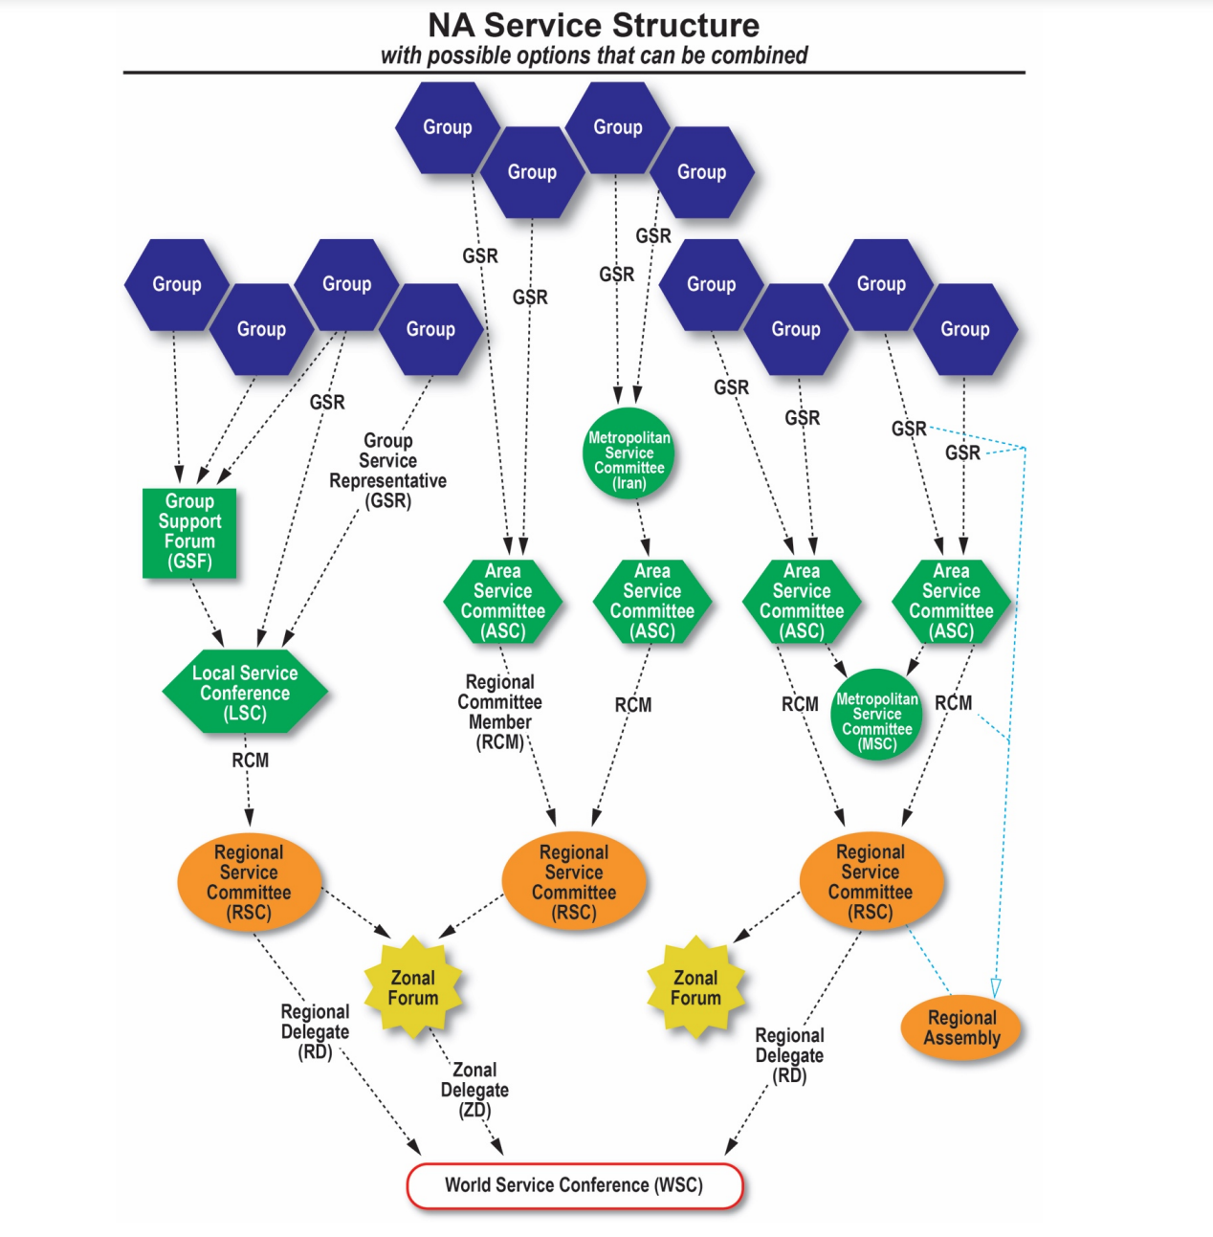
NA Service Structure
Groups may send GSR’s to Area Service Committee
Areas send RCM’s (Regional Committee members) to the Regional Service Committee
Regions send RD’s and AD’s (Regional and Alternate Delegates) to Zonal Forums as well as to the WSC (World Service Conference)
Zones may also send representatives to the World Service Conference.

Slide 28
Zonal Forums
Level of service between regions and world
Some have votes at the WSC, all are WSC participants
15 zonal forums around the world
8 zonal forums in the continental United States and Alaska
Louisiana associates with the Southern Zonal Forum, which includes 10 regions
SZF does not have a vote at WSC

